Slide 1





Success Academy Trust Calculation Policy (Primary)

Slide 2
Addition

Slide 3







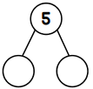

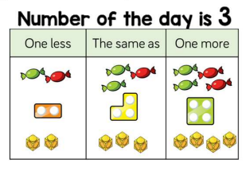
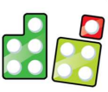




Early Years Addition | Concrete | Pictorial | Abstract
Count objects, actions and sounds | -Children begin by counting concrete manipulatives and are encouraged to organise into a line and tag each object as they count with 1-1 correspondence |  | Children count actions and sounds e.g. can you jump 4 times? How many times does your friend jump up and down? Can you clap 5 times? How many times does your teacher clap?
Explore the composition of numbers to 10 | Build numbers using concrete manipulatives e.g. 5 frame | -Combine groups of objects using concrete manipulatives e.g. object pic, 5/10 frame, ppw, numicon, fingers | -Children are encouraged to say number sentence out loud e.g. 2 add 1 equals 3 -Children record their mathematical graphics using pictures, numbers, words and symbols.
Recall number bonds for numbers to 5 and some to 10 | Explore using Part-part-whole, 5 and 10 frames, fingers, numicon. | Explore using Part-part-whole, 5 and 10 frames, fingers, numicon. | Recall without the need for objects or models 1 + 4, 3+ 2, 5 + 0 etc
Understand the ‘one more than/one less than’ relationship between consecutive numbers | Explore using concrete manipulatives on a 5 or 10 frame, using a number track/counting stick. | Children draw the number on a 5 frame and show one more or one less | To know mentally 1 more than 6 is 7 I less than 8 is 7
Subitise – to know the amount in a group without counting (up to 5) dot cards | To subitise with objects | To subitise pictorially

Slide 4
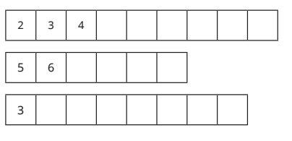
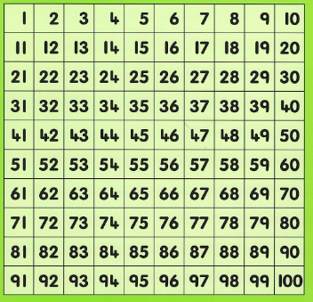



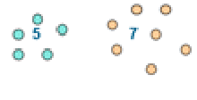
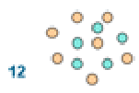


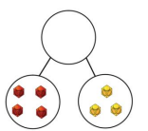




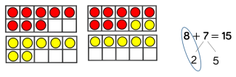
Year 1 Addition | Concrete | Pictorial | Abstract
To count on forwards and backwards from a number within 1s, 2s, 5s and 10s |  |  | 7, 8 , 9 , 10, 11 19, 18, 17, 16 4, 6, 8, 10 50, 40, 30,
Add single digits within 10 and 20 | I can count 4 objects and 3 objects and combine them to make 7 objects |  | 4 + 3 = 7 3 + 4 = 7 3 + ___ = 7 7 = __ + 4
Number Bonds within 10 & Number Bonds to 10 | Use objects to combine 3 and 4 | 3 is a part, 4 is a part, 7 is the whole | To mentally know 3 and 4 is 7 3 + 4 = 7 3 + ___ = 7 7 = __ + 4
Number Bonds within 20 & Number Bonds to 20 | Using Dienes blocks to combine 14 and 5 is 19 | To use jottings to show 12 + 4 = 16 | To mentally know 14 + 5 = 19 14 + 5 = 19 14 + ___ = 19 19 = 14 + ___
Counting on method within 10 and 20 | Using physical objects to make a 2 groups and count on from the first group | 4 + 3 = 7 I start at 4 and count on 3 more | I can put 4 in my head and count on 3 more to make 7 ___ plus____ is equal to ______ 3 more than 4 is 7 The total of 3 and 4 is 7 There are 7 altogether 3 and 4 makes 7
Using bridging to add 8 + 7 | Using a tens frame to show to show making 10 first |  | In my head I can have 8 and 7 by making 8 and 2 and 5

Slide 5





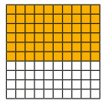

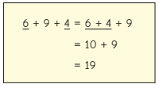


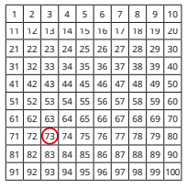
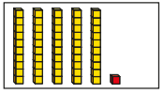







Year 2 Addition | Concrete | Pictorial | Abstract
Adding across 10 |  |  | 8+5 = 10 +3 26+5=31 (26+4+1=31)
Related facts |  |  | If I know 3+5=8 Then I know 30 + 50 = 80
Bonds to 100 |  |  | 4+6=10 40+60 =100 100 = 40 + ___ I need 100 balloons. I have 40, how many more do I need?
Add 3 1 digit numbers |  |  | 6+9+4 = 19
Adding 9 and 11 Using 10 |  |  | 14 + 9 = 14 + 10 – 1 14 + 11 = 14 + 10 + 1
Add 10 more & Adding multiples of 10 |  |  | 37+10=47 26+50=76 Class 2 has 26 crayons. There are 10 more crayons everyday for 5 days.
Adding 2 digit numbers not across a 10 |  |  | 53 + ____ = 94 94 = 53 + ____
Adding 2 digit numbers across a 10
+
 | 5 | 3
+ | 4 | 1
 | 9 | 4
+

Slide 6
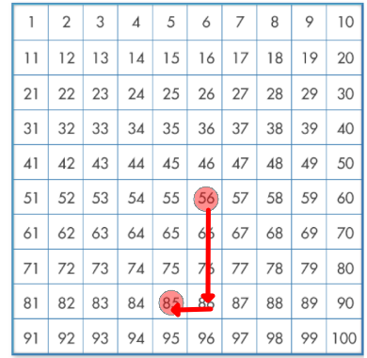
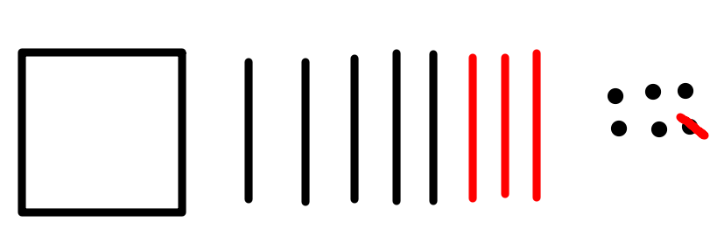
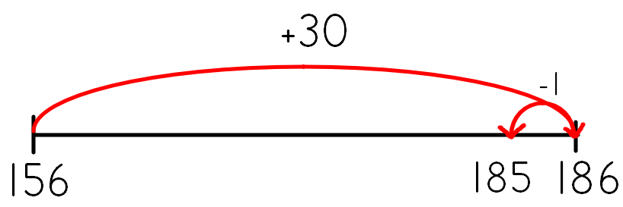
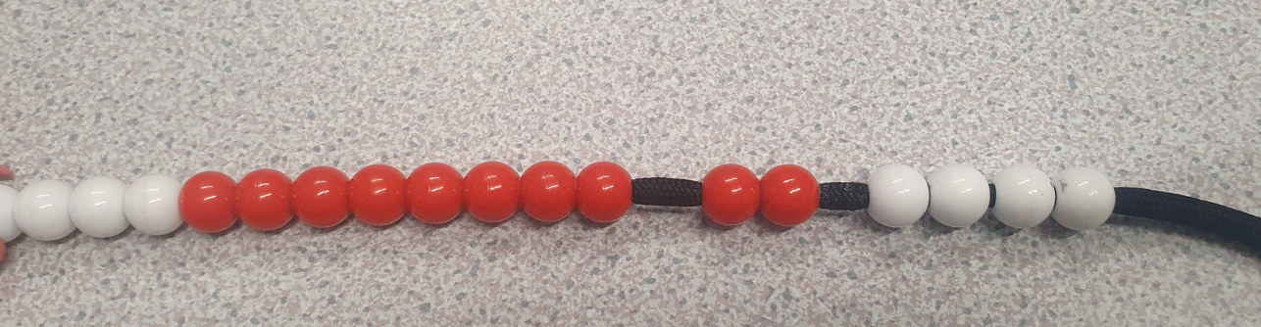
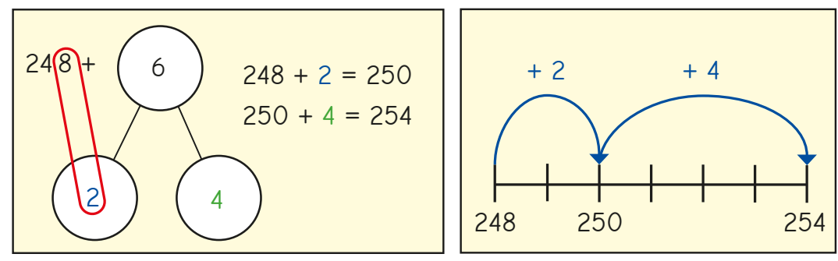
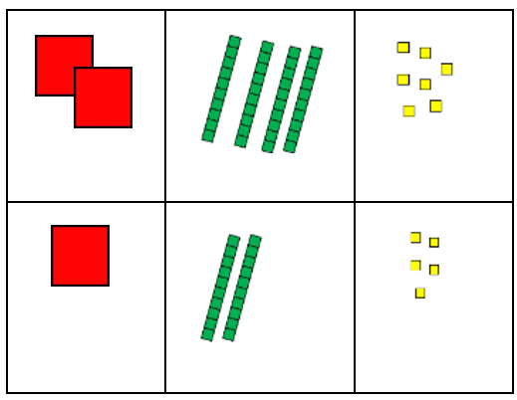
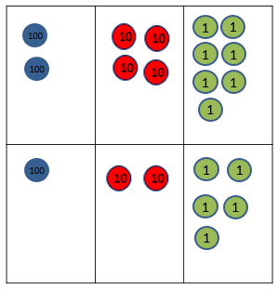
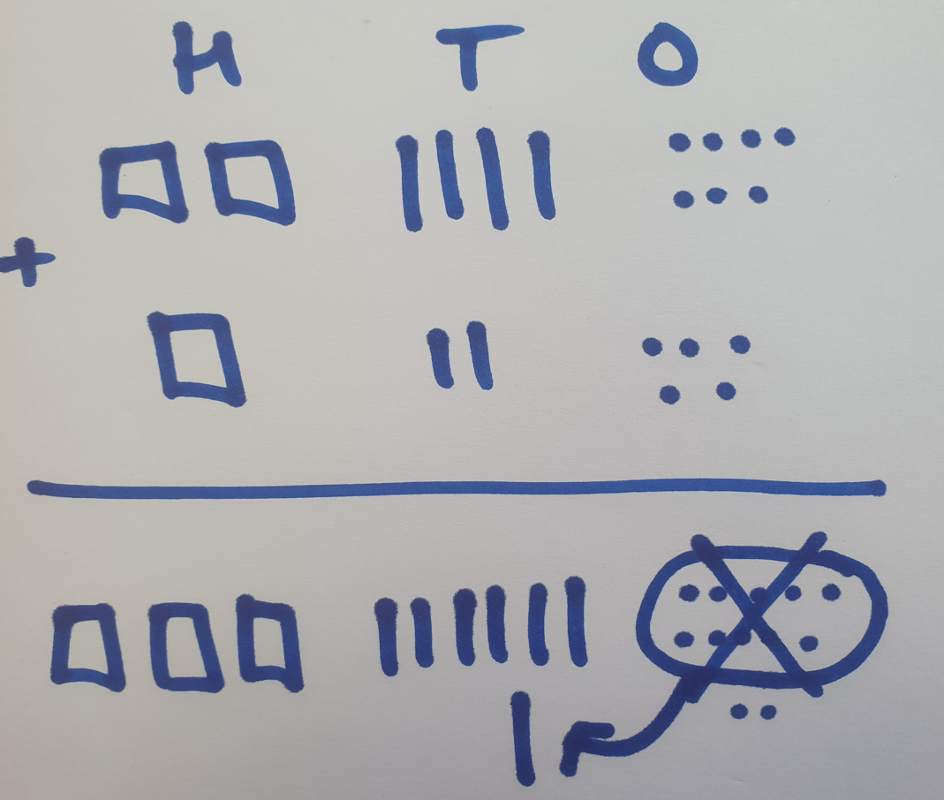
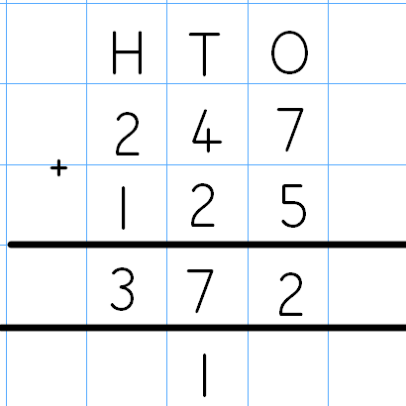
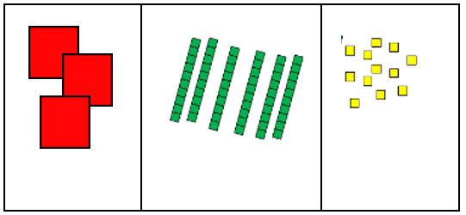
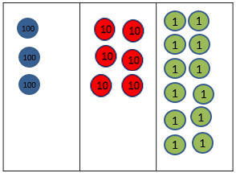
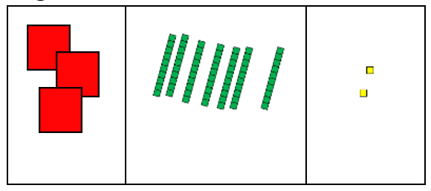
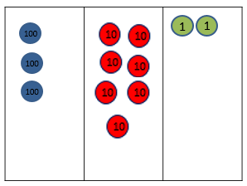
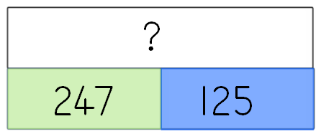
Year 3 Addition | Concrete | Pictorial | Abstract
Add one a multiple of 10 or 100 and adjust . | Use a hundred square and move counters to show adding 30 then moving back one. | Children draw jottings to show method of adding tens and adjusting the ones. | 156 + 29 156 + 30 = 186 186-1= 185 Perform this method mentally.
Bridging across the ten | Use a bead string to show partitioning the addend to bridge over the ten. | Children partition the addend to bridge to the next ten and represent this with jottings or a number line. | 248 + 6 248 + 2 = 250 250 + 4 = 254 Mental calculation bridging the ten.
Formal column addition | Partition numbers horizontally and add each place value column. Add up the ones and exchange 10 ones for a ten. | Children can draw a pictorial representation of the columns and place value counters to further support their understanding. Bar models used to represent calculations and word problems. | Children use formal column addition where the exchanged ones is written as a ten underneath the tens column. Calculations where ten tens are exchanged for one hundred represented in the same way.

Slide 7
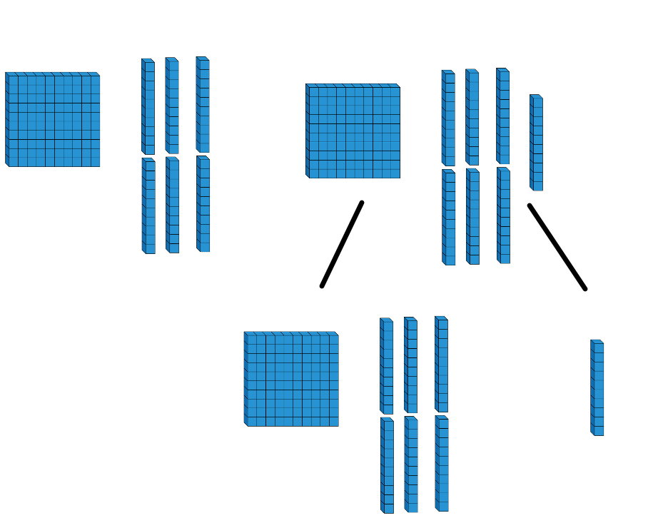
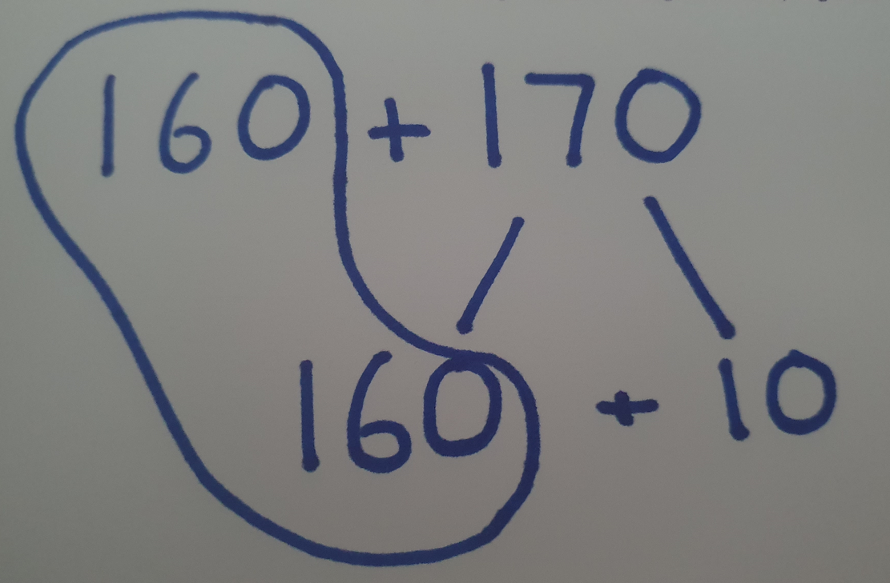
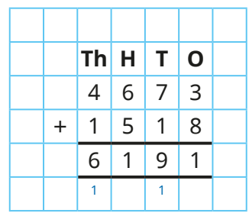
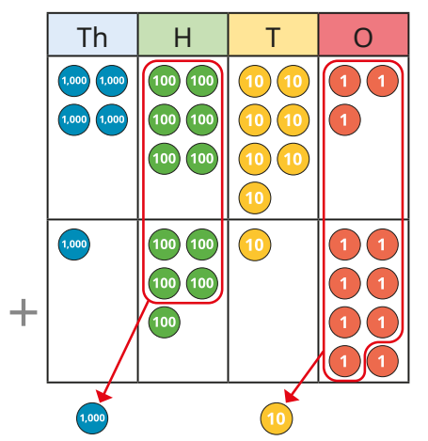
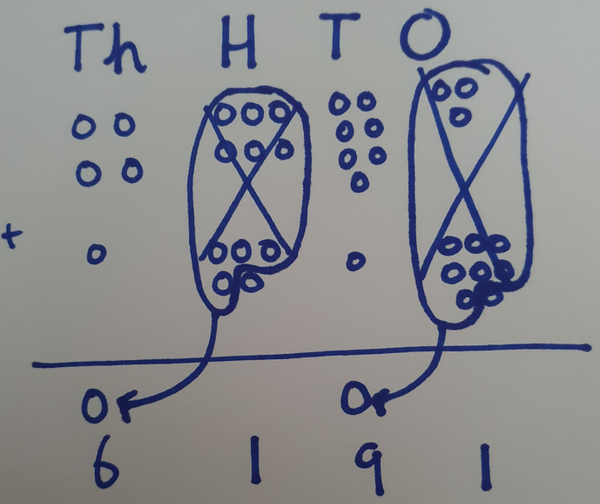
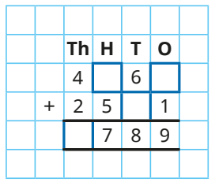
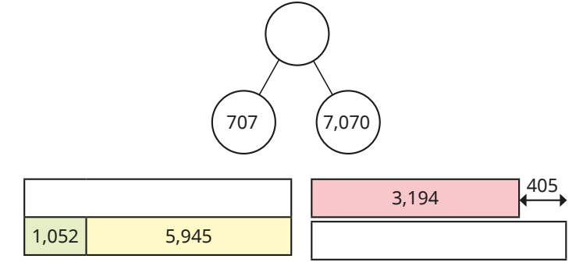
Year 4 Addition | Concrete | Pictorial | Abstract
Partitioning using ‘near’ doubles to add. | Use diennes to partition showing near doubles | Children use a partitioning method to add using near doubles. | Children can use near doubles and adjust accordingly 160 + 170 is double 150 + 10 + 20 OR double 160 + 10 OR double 170 -10 Perform this method mentally.
Formal column addition with 4-digit numbers. | Partition numbers up to 4-digts horizontally and add each place value column. Exchange using counters. | Children can draw a pictorial representation of the columns and place value counters to further support their understanding. | Children use formal column addition with exchanges. Find missing numbers and digits.

Slide 8
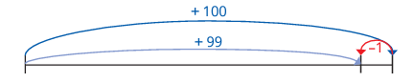
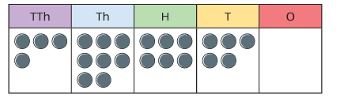
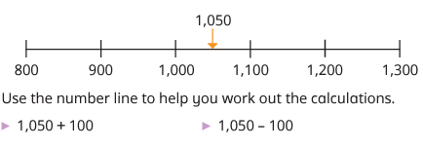
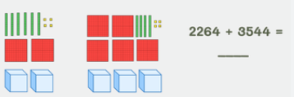
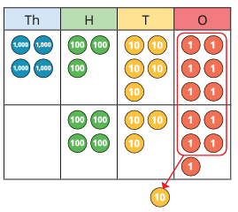
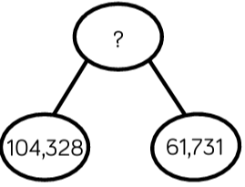
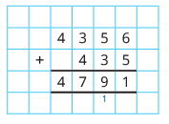
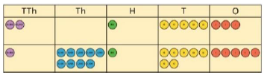
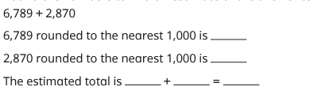
Year 5/6 Addition | Concrete | Pictorial | Abstract
Mental addition | Use a place value chart to help with additions. 48,650 + 300 = 48,650 + 10 = 1,210 + 48,650 = | Using a number line to help with mental calculations. | 3,724 + 999 = 3724 + 990 = 590 + 590 = The sum of ____ ones and ____ ones is ____ ones, so the sum of ____ thousands and ____ thousands is ____ thousands. I can partition the number into ____, ____ and ____ and add the parts separately.
Add whole numbers with more than 4 digits | Use place value equipment to represent additions. Exchange 10 ten counters for 1 hundred counter. | Draw different representations of equipment on a place value grid. I need to exchange 10 ones for 1 ten. Use bar models to add two or more numbers. | Column addition including exchanging. The digit ____ in the ____ column represents ____. Round numbers to find an estimate total.

Slide 9
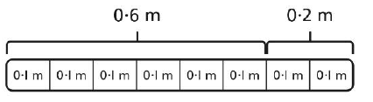



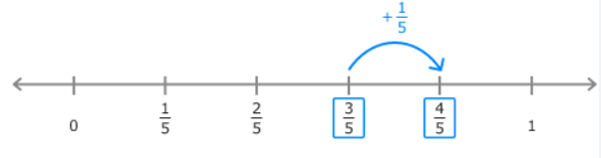
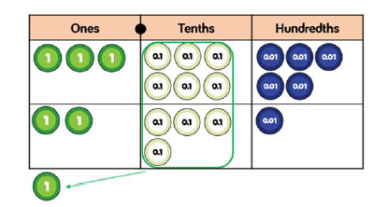

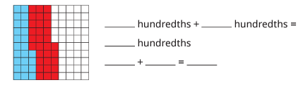
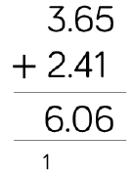

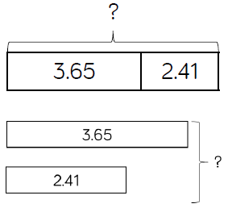
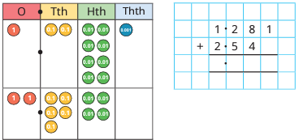

Adding fractions | Use a variety of manipulatives to add different fractions. |  | Add the wholes separately to the fractions. I can regroup ____ to make ____ wholes with ____ parts left over. As a mixed number, this is ____ and ____. The mixed numbers can be partitioned into a ____ part and a ____ part.
Adding decimal numbers | Use place value manipulatives to add decimals and exchange when necessary. | Linking decimals to a hundred square. | The first number is ____ away from 1. The second number can be partitioned into ____ and ____. The total is 1 + ____ =

Slide 10
Subtraction

Slide 11





EY Subtraction | Concrete | Pictorial | Abstract
Explore the composition of numbers to 10 | Use concrete resources to count out a group and relate this to subtraction -taking away and counting how many objects are left. | Children record their mathematical graphics using pictures, numbers, words and symbols. | Children are encouraged to say the number sentences out loud and in different ways e.g. 6 subtract 4 equals 2, 6 minus 4 equals 2, 6 take away 4 makes 2.
Recall number bonds for numbers to 5 including subtraction facts | Explore using Part-part-whole, 5 and 10 frames, fingers. | Explore using Part-part-whole, 5 and 10 frames, fingers. | To know number bonds to 5 off by heart E.g. 5 + 0, 4+1, 3 + 2, 5 – 3 = 2 etc
Understand the ‘one more than/one less than’ relationship between consecutive numbers | Explore using concrete manipulatives on a 5 or 10 frame, using a number track/counting stick. | Explore using pictures on a 5 or 10 frame, using a number track/counting stick. | To know mentally 1 more than 4 is 5 1 less than 7 is 6
6-2=4

Slide 12

















Y1 Subtraction | Concrete | Pictorial | Abstract
Subtraction taking away how many left (crossing out method) | Have 7 cubes in a bag. I take out 3 cubes. I have 4 left. Use First, Then and Now I have 6 frogs, 3 leave the lily pad. I have 3 left. | 7 birds are in the tree. 3 fly away. Children to use pictures to cross out | Children to use the crossing out method to solve subtraction problems with the symbol. 5 – 2 = 3
Subtraction finding 1 part and breaking apart
Fact Families – 8 parts | 5+1 = 6 1 + 5 = 6 6 – 1 = 5 6 -5 = 1
Subtraction – Counting Back | Using a physical number line, children can jump back physically along a number line or number track |  | I can count back in my head 7 – 4 = 3 7, 6, 5, 4 , 3
Subtraction – Finding the difference by counting on |  |  | I can find the difference between 2 numbers by counting on in my head. E.g. The difference between 17 and 20 is 3. 17, 18, 19, 20.
Subtracting crossing 10 – Choosing the best method: | Take away as crossing out: Max has 12 balloons, 5 of them burst, how many are left? | Partitioning Max has 12 balloons. 5 are red. The rest are blue. How many are blue? | Max has 12 blue balloons. He also has 5 red balloons. How many more blue balloons does he have?

Slide 13









Year 2 Subtraction | Concrete | Pictorial | Abstract
For subtracting single digits – see Year 1 | See Year 1
Subtraction – 10 less | Use blocks to show taking away 1 ten | Showing ten less on a 100 square to show going back 1 row The ones stay the same | To know 10 less mentally
Subtracting tens | Use blocks to show taking away 2 tens | Showing ten less on a 100 square to show going back more than 1 row The ones stay the same | To know mentally
Subtracting 2 digit – 2 digit no bridging | To show 76-24
Subtracting 2 digit – 2 digit with bridging

Slide 14










Year 3 Subtraction | Concrete | Pictorial | Abstract
Choose efficient mental strategies e.g. counting on to find the difference | Make the number with diennes and count up to see what the difference between the numbers is. | Children count up to find the difference on a number line. | Counting up in their head to find the difference e.g. 201 – 198 = 3
Adjust numbers using the constant difference | Use bead strings to explore constant difference e.g. 11 – 3 = 10 – 2 = 8 | Use number lines to show that the difference is constant when adding or subtracting one from both numbers. | Adjusting numbers by adding or subtracting one to find the constant difference. e.g. 400 – 239 = 399 – 238 = 61
Formal column subtraction with 3-digit numbers | Partition numbers horizontally using diennes or place value counters and subtract each place value column, making exchanges i.e. one hundred exchanged for 10 tens. | Draw a pictorial representation of the columns and diennes or place value counters, showing the exchange by crossing out and re-drawing. Bar models and part whole models used to represent calculations and word problems. | Children use formal column subtraction where exchanges between columns are shown by crossing out the digit. Missing number problems e.g. □ = 43 – 27; 145 – □ = 138; 274 – 30 = □; 245 – □ = 195; 532 – 200 = □; 364 – 153 = □

Slide 15





Year 4 Subtraction | Concrete | Pictorial | Abstract
Formal column subtraction with 4-digit numbers | Partition numbers horizontally using diennes or place value counters and subtract each place value column making exchanges. | Draw a pictorial representation of the columns and diennes or place value counters, showing the exchange by crossing out and re-drawing. Bar models and part whole models used to represent calculations and word problems. | Children use formal column subtraction where exchanges between columns are shown by crossing out the digit. Missing number problems e.g 456 + □ = 710; 1□7 + 6□ = 200; 60 + 99 + □ = 340; 200 – 90 – 80 = □; 225 - □ = 150; □ – 25 = 67; 3450 – 1000 = □; □ - 2000 = 900

Slide 16








Year 5/6 Subtraction | Concrete | Pictorial | Abstract
Mental subtraction | Use place value equipment to assist with subtractions. | Using a number line to help with mental calculations. | Counting forwards and backwards in tenths and hundredths: 1.7 + 0.55 Reordering: 4.7 + 5.6 – 0.7, 4.7 – 0.7 + 5.6 = 4 + 5.6 Partitioning: counting on or back - 540 + 280, 540 + 200 + 80 Partitioning: bridging through multiples of 10 Partitioning: compensating: 5.7 + 3.9, 5.7 + 4.0 – 0.1 Partitioning: using ‘near’ double: 2.5 + 2.6 is double 2.5 and add 0.1 or double 2.6 and subtract 0.1
Subtract whole numbers with more than 4 digits | Use place value equipment to represent subtractions of larger numbers. | Draw different representations of subtractions with place value equipment. | Use column subtraction when mental methods are not efficient.
Mental Strategies Constant Difference | Through the use of a physical number line – e.g. paper tape measure physically cut the tape to show the difference is the same |  | 1000 – 372 = 999-371
Subtraction of 4 digit numbers | 45,536 – 8,426 = 37,110 | Children represent this with drawings of place value charts.
 | 9 | 9 | 9
- | 3 | 7 | 1
 | 6 | 2 | 8

Slide 17
Multiplication

Slide 18




EY Multiplication | Concrete | Pictorial | Abstract
Recall number bonds to 5 and some to 10 including double facts | -Children learn that ‘double means the same again’. -Using concrete manipulatives such as ladybirds and spots, butterflies, unifix, numicon and a part-part-wholes, children explore this concept. -They count out a set amount of objects e.g. 4 cubes and then count out the same again before counting how many altogether. | -Children also use a part-part-whole to put the same amount of objects into both parts before moving to the whole and counting to find double. | To know mentally the double facts up to 10. I know double 3 is 6. I know double 5 is 10

Slide 19
















Year 1 Multiplication | Concrete | Pictorial | Abstract
Count in 2s, 5s and 10s |  |  | Children should memorise and reason with numbers in 2, 5 and 10 times tables
Recognise equal groups | Using concrete resources – can you make equal groups with 2s, 5s and 10s. | Can you recognise equal groups within pictures? | Make equal groups by drawing additional representations
Add equal groups | Counting physical objects: | Counting from a pictorial representation: | Use the calculation for repeated addition 5 + 5 + 5 = 3 groups of 5 = 15
Make arrays | Make physical arrays with counters and objects | Using pictures to count the rows and columns to describe the arrays | Drawing arrays from a number sentences or story
Make doubles | Using 2x tens frames to physically make doubles with concrete objects | Using 2x tens frames to draw representations | To know the double facts Double 3 is 6 Double 6 is 12
Use arrays to understand multiplication can be done in any order (commutative) |  |  | To know 2 x4 = 8 and 4 x 2 = 8

Slide 20


















Year 2 Multiplication | Concrete | Pictorial | Abstract
Recognise equal groups | Gather objects and put into equal groups of 2s, 3s, 5s and 10s | Use pictures to recognise equal groups | Draw equal groups: and make equal groups by drawing additional representations
Make equal groups | Use physical objects to make equal groups | Use pictures to describe equal groups | Make or draw groups
Add equal groups |  | Using pictures of equal groups to add | Use drawings and jottings to draw and add equal groups Use the number sentence to count the groups
Use multiplication sentences To know the 2x, 5x and 10x table | Use concrete resources to make groups and write the corresponding multiplication sentence | To recognise pictures as multiplication sentences and begin to write the matching calculation | Children should practise times table facts 2 x 1 = 2 x 2 = 2 x 3 =
Use arrays | Make arrays with physical equipment and objects | Use the array to write the corresponding number sentences 6 x 3 = 18 3 x 6 = 18 | Draw an array from a given number sentence
To count in 2s, 3s, 5s and 10s forwards and backwards | Use a clock face to support understanding of counting in 5s. Use money to support counting in 2s, 5s, 10s, 20s, 50s |  | Children should practise times table facts 2 x 1 = 2 x 2 = 2 x 3 =

Slide 21
















Year 3 Multiplication | Concrete | Pictorial | Abstract
Equal groups | There are 3 equal groups with 3 in each group. There are 9 counters altogether. | There are 3 equal groups with 5 in each group. There are 15 pears altogether. | 5 + 5 + 5 = 15 3 x 5 = 15
Arrays | There are 4 rows of 3 counters. 4 x 3 = 12 There are 3 columns of 4 counters. 3 x 4 = 12 | 4 x 5 = 20 5 x 4 = 20 | 4 x 3 = 12 3 x 4 =12
Sharing & Grouping |  |  | 5 x 4 = 20 4 x 5 = 20 20 ÷ 5 = 4 20 ÷ 4 = 5
Multiply by 3, 4, 8 | 5 equal groups. 3 in each group. There are 15 cubes altogether. |  | 8 x 3 = 24
Multiples of 10 | 17 x 10 = 10 x 10 + 7 x 10 = |  | 23 x 10 = __ x 10 = 280
Related calculations |  | 2 x 4 = 8 2 x 40 = 80 | 2 x 8 = 16 2 x 80 = 160

Slide 22





Year3 /4 Multiplication | Concrete | Pictorial | Abstract
Multiply 2 digit by 1 digit (exchanges) | 3 tens x 2 = 2 ones x 2 = ____ + ____ = 32 x 2 = | 20 x 3 = 3 x 3 = ___ + ___ = 23 x 3 = | 42 x 2 = 40 x 2 = 80 2 x 2 = 4 80 + 4 = 84
Multiply a 2 digit by a 1 digit (no exchange) |  |  | 73 x 5 70 x 5 = 350 3 x 5 = 15 350 + 15 = 365

Slide 23










Year 5/6 Multiplication | Concrete | Pictorial | Abstract
Multiply by 10, 100, and 1,000 | Use place value equipment to multiply through unitising. | Represent multiplication as exchange on a place value grid. | Multiply numbers including decimals by 10, 100, 1000 using moving digits across place value columns. There were ___ ones/tens. Now there are ___ tens/hundreds
Multiply by multiples of 10, 100 and 1000 | Use place value equipment to multiply through unitising. 5 groups of 3 ones is 15 ones 5 groups of 3 tens is 15 tens 5 groups of 3 hundreds is 15 hundreds etc. | Draw place value representations to show how to multiply by multiples of 10, 100 and 1,000. | Use known facts and unitising to multiply. 5 x 4 = 20 5 x 40 = 200 5 x 400 = 2,000 4,000 x 5 = 20,000 ___ = ___ × ___ , so to multiply by ___ you can first multiply by ___ and then by ___.
Multiply a 4 digit number by a 2 digit number | Use place value equipment to help understand the size of numbers. The grid method can be used | Draw multiplications in different representations. | Doubling to solve x2, x4, x8 Understand the link to repeated addition. Multiplying using the formal written method.
First, I multiply ___ by ___ ones.
Then I multiply ___ by ___ tens.
Finally, I add together ___ and ___.

Slide 24
Division

Slide 25






EY Division | Concrete | Pictorial | Abstract
Explore how quantities can be distributed equally | Children share concrete manipulatives between a number of teddies. They explore which numbers can be shared fairly and which cannot. | Children can halve using a part-part-whole. Put the whole amount into the whole and then share between the 2 parts (halves). | Children know mentally how numbers are halved. Some children will make the link between sharing into groups of 2
Explore and represent patterns within numbers up to 10 including odds and evens | Children have opportunities to explore which numbers to 10 can be shared equally ‘odd numbers can’t be shared equally’. |  | I know 1, 3, 5, 7, 9 are odd numbers I know 0, 2, 4, 6, 8 are even numbers

Slide 26








Y1 Division | Concrete | Pictorial | Abstract
Children should be able to count forwards and backwards in 2s 5s and 10s |  |  | Children should memorise and reason with numbers in 2, 5 and 10 times tables
To make equal groups - grouping | Using Numicon to find out how many 3’s are in 15? | Use of arrays as a pictorial representation for division
To make equal groups – sharing | Children should be taught to share using concrete apparatus. | Using jottings to represent objects Share 9 apples between 3 plates | Can count in 2s, 5s and 10s to calculate a division problem
To halve a number by sharing into 2 equal groups |  |  | To know mentally half of 12 is 6

Slide 27



















Year 2 Division | Concrete | Pictorial | Abstract
Make equal groups Grouping | Use concrete resources to show the grouping of numbers
Make equal groups Sharing | Share these counters into equal groups | Use a bar model to show 20 shared into 4 groups: | Use the multiplication sentence to show the corresponding division
To divide by 2 | To use physical objects including fingers to count in groups of 2s | To use a number line to count back in twos | To mentally count back in 2s and be able to say how many 2 go into a number
To divide by 5 | To use physical objects to divide by 5
To divide by 10 |  |  | To solve missing numbers within 10x table
Halving |  | Use the jottings method to share into 2 groups | To know how to mentally halve numbers to 20
Recognise odd and even numbers |  |  | Numbers ending with 1, 3, 5, 7 and 9 are odd Numbers ending with 0, 2, 4, 6, 8 are even

Slide 28









Year 3 Division 2 digit by 1 | Concrete | Pictorial | Abstract
Sharing into groups | Using diennes or counters, children share resources equally into groups starting with the tens. Where an exchange is needed, children should exchange the tens that cannot be shared equally into the groups into ones and share those. | Tens and ones drawn shared into groups. Where leftover tens cannot be shared equally, these should be shared as ones. | Using flexible partitioning and a bar model to share out equally.
Division using a number line. | Numicon can be used to show ‘How many 4s fit in 68?’ by layering 4s over the 68. Introduce the number line alongside. | Children draw a number line and the tens and ones for the number to be divided. Thinking ‘How many 4s fit in 68?’ Jump in chunks of 4 e.g 10 lots of 4 = 40 Cross out the tens and ones as you use them. Questions with remainders solved in the same way. | Same as pictorial with drawing the tens and ones as optional. Becomes flexible partitioning with the aid of a number line. The number line should still be encouraged.
Division by partitioning and flexible partitioning. | Using diennes, numicon or place value counters. Flexibly partition into multiples of the divisor. A multiplication grid can be used to solve times tables. | Children draw tens and ones to help flexibly partition into multiples then divide. | Mental flexible partitioning with the aid of a multiplication square.

Slide 29




Year 4 Division 2 digit by 1 digit and 3 digit by 1 digit | Concrete | Pictorial | Abstract
Bus stop division no carrying. | Bus stop method of division introduced using numicon to support finding how many of the divisor fits into the number. Care should be taken to explain the place value e.g. 600 ÷ 3 = 200 | Bus stop division with multiplication square as support. | Bus stop division using mental times tables.
Bus stop division with carrying. | Bus stop method where a ten or hundred is carried over to the next column. Numicon to support finding how many of the divisor fits into the number.

Slide 30








Year 5 Division | Concrete | Pictorial | Abstract
Divide by 10, 100 and 1,000 | 3,210 ÷ 10 = 321 | Pupils will show jottings on their place value charts by: Divide by 10 (moving each digit 1 place to the right) Divide by 100 (moving each digit 2 places to the right) Divide by 1,000 (moving each digit 3 places to the right) | 64,000 ÷ 100 = 640
Short division | 605 ÷ 5 = 121 (One of the hundreds counters is exchanged for 10 tens) | 40 ÷ 4 = 10 8 ÷ 4 = 2 So 48 ÷ 4 = 12
Divide a 4 digit number by a 1 digit number | 4,892 ÷ 4 = 1,223 Using exchanges (see short division) | Pupils will need to be able to partition numbers into multiples of the divisor (4).

Slide 31



 | Concrete | Pictorial | Abstract
Divide with remainders | 4.894 ÷ 4 = 1,223 r2 Exchanges (see short division) 2 ones counters remaining = remainder 2
Notes:
,89

Slide 32








Year 6 Division | Concrete | Pictorial | Abstract
To use short division | To use physical place value counters to show 8524 ÷ 4 | To use jottings method to show division as a partitioning method | To use partitioning to show the place value of 8000 ÷ 4 = 2000 400 ÷ 4 = 100 120 ÷ 4 = 30 4 ÷ 4 = 1 To use the short method for division
Long Division | Support around squared paper and setting out the calculation | To use the jottings of multiplication facts | To move to the compacted methos for long division
Long Division with remainders | Support around squared paper and setting out the calculation To use rules of divisibility to support with calculations E.g.: If a number is divisible by 3 and 4, it will also be divisible by 12. | To use the jottings method as a list of multiplication facts | To move to the compacted Method for short division

Slide 33
Acknowledgement of sources for ideas and materials included in this policy.
This policy has been adapted using sources from the following:
White Rose – Schemes of Learning
PDF schemes of work. Can be accessed free of charge here:
Materials taken from the White Rose Calculation Policy found here:
National Centre for Excellence in the Teaching of Mathematics:
PowerPoint slides courtesy of the NCETM – PD Lead Support Programme 2013. Crown Copyright. Also materials used from NCETM website https://www.ncetm.org.uk/
(to access the NCETM materials, you will need to register to set up an account – this is free of charge)
Leicestershire School Improvement Service:
Leicestershire County Council calculation policy and other training resources produced by the School Improvement Service (e.g. SAN questions for division; progression in numbers used in division calculation; other PowerPoint slides)
The National Strategies:
Teaching Children to Calculate Mentally. DfE 2010
Mathematical Vocabulary. DfES 2000
Models and images for understanding and manipulating numbers in Year 1 to 3. DfES 2003
University of Northampton / Nottingham Trent University:
Materials from the Maths Specialist Teacher Programme

